Slide 1

Intro to Suricata
Notes:
Below is a list of all keywords to unlock each Exercise.
This information will be repeated on the appropriate slide
CTFd FLAG LISTING
Exercise: "Basics"
unlock flag: "memory"
Exercise: "Configuration"
unlock flag: "sector"
Exercise: "Execute!"
unlock flag: "notice"
Exercise: "Setup"
unlock flag: "offset"
Exercise: "Basic-Rules"
unlock flag: "danger"
Exercise: "HTTP-Rules"
unlock flag: "switch"
Exercise: "DNS-Rules"
unlock flag: "vision"
Exercise: "Regex"
unlock flag: "horse"
Exercise: "PCRE-Rules"
unlock flag: "staple"

Slide 2
Suricata
The term NSM covers a lot of concepts, tools, and techniques. One of these is a traditional
(I)ntrusion
(D)etection
(S)ystem
Notes:
Suricata has quickly become the IDS of choice for ROCKnsm.

Slide 3
Suricata
- Open Information Security Foundation
- Active community
- Truly open source (not tied to corp.)
- Fast rule writing / updating cycle
- Multithreaded (scaleable)
Notes:
Suricata is licenced under GPL to ensure no corporate overlords, though it has two platinum sponsors (>$150k / year) that get non-gpl privileges.

Slide 4
Terminology
NSM: Network Security Monitoring
- gathering network activity
- data about data
- event-based information (bro logs)
- lots of information (PCAP)

Slide 5
Terminology
IDS: Intrusion DETECTION
- out-of-band
- passive
- bruteforcing
- suspect IP addresses
- malware detection
- portscanning
Notes:
does not affect things on the network
does not make changes
-passively identifies
- bruteforcing through threshold detection
- known malicious or suspicious IP signatures
- known bad binaries/hex
- portscanning detection

Slide 6
IPS
Intrusion PREVENTION
- in-band
- active
Notes:
can make changes to networks through blocking attempts

Slide 7
The Problem to Solve
- We know what a lot of bad looks like
- Network documentation / unknowns
- Over-complexity (byod, containers, vms, embedded, etc.)
Notes:
dont want to spend too much time analyzing the same thing over and over
poor net maps and docs present additional challenges
complex networks with many devices and different mismatched policies

Slide 8
What is Suricata?
Suricata uses a rule-set to compare against incoming traffic and it fires off alerts if it matches on a rule.
- IDS
- Multithreaded! (scalability)
- Rules / signatures written to find known bad
- Extended Snort Language
Notes:
The multithreaded thing was one of the original reasons for Suricata. The community had asked Snort developers to create a multi-threaded version for years, but they never did until 3.0, which is still in Beta

Slide 9
What it Does
- Extracts files (http & smtp)
- IPv4 / v6
- GeoIP / reputation
- Port-independent protocol detection
Notes:
- anyone notice some feature overlap on last 2 slides?
- Bro: IDS / file extraction / proto detection

Slide 10
What it Does
- Outputs to `eve.json`
- DNS parse / match / log
- "NSM runmode" - just events (no alerting)
Notes:
- have volunteer look in /etc/sur/sur.yml for eve.json - NSM runmode: more Bro overlap?
Extensible Event Format

Slide 11
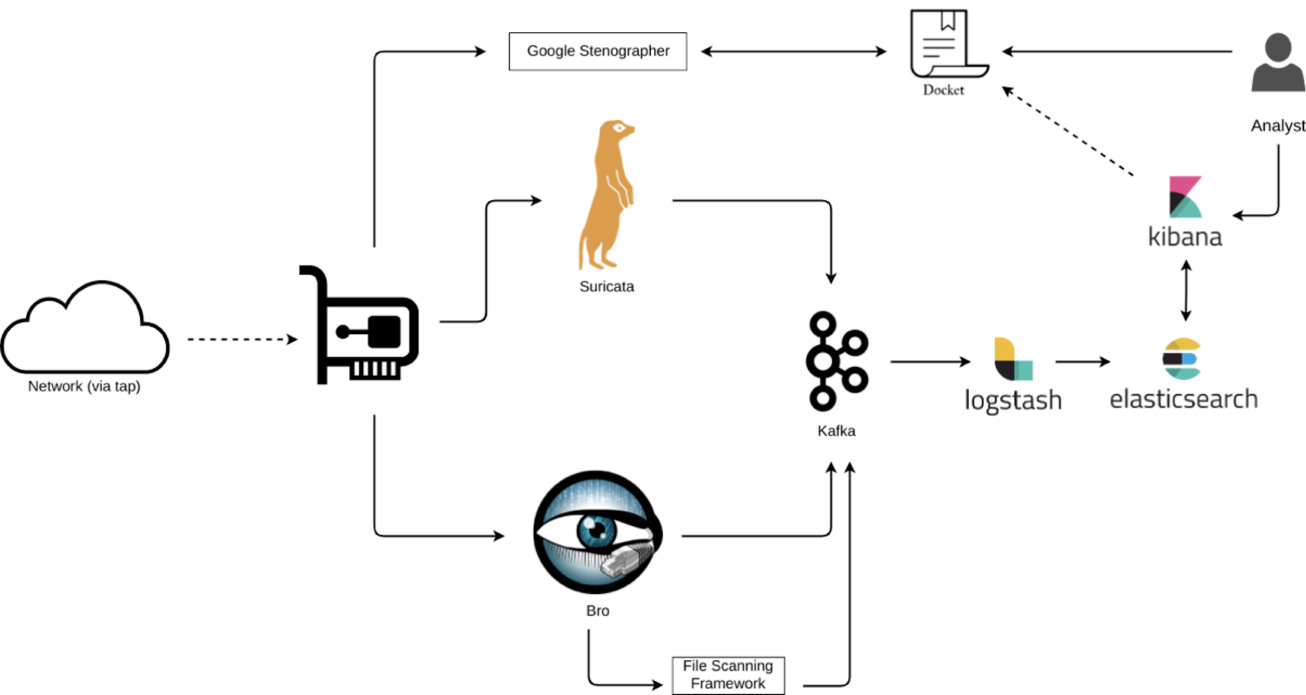

Slide 12
Exercise: Basics
CTF key: “memory”
Notes:
1. ensure that the suricata .zip file has been imported
2. have all students register with their assigned student# and login CTFd
unlock flag: "memory"
This exercise is an easy multi-choice, basically a "check on listening".

Slide 13
Basic Suricata Setup
On CentOS, we can install Suricata with yum, but we need to get it from EPEL
Enable EPEL yum repository
Install Suricata and jq (useful for exercises)
Install some rules (we’ll get to this later)
Notes:
Don’t actually do this, just talking points. - epel == extra packages enterprise linux - emerging threats - great resource

Slide 14
Install Suricata
Add epel repository:
sudo yum install -y epel-release
Install Suricata:
sudo yum install -y suricata
sudo yum install -y jq
Notes:
talk about managing Suricata service: enable it

Slide 15
Configuration Walkthrough
Primary config file: /etc/suricata/suricata.yml
Define vars to describe your network
Choose rules to enable or disable
Choose your outputs
Define capture settings
Adjust Application Layer Protocol options (if desired)
Notes:
- defining networks is critical, feeds all signature writing
- We need to ensure eve.log is active so that we can get JSON output

Slide 16
Configure
Primary config file: /etc/suricata/suricata.yaml
line 15: define local networks
line 55: default-log-dir: /data/suricata/logs
line 59: global stats: `no`
line 75: no # disables a log called fastlog
line 82: eve.log: yes
Notes:
- defining networks is critical, feeds all signature writing
- We need to enable eve.log so that we can get JSON output
line 15: define local networks
line 55: default-log-dir: /data/suricata/logs
line 59: global stats: `no`
line 75: no # disables a log called fastlog
line 82: eve.log: yes

Slide 17
Configure
/etc/sysconfig/suricata
- AFpacket Setting: specifies collection interface to use AFpacket
OPTIONS="--af-packet=interface_name"
Notes:
- describe generally why afpacket over pf-ring
speed and efficiency

Slide 18
Configure
1. Create the directory for Suricata to write logs to:
mkdir -p /data/suricata/logs
2. Give the Suricata user permissions to write:
chown -R suricata:suricata /data/suricata
Notes:
RockNSM example for log directory structure
Let's break down what's happening in example #2 above
- change ownership
- recursively
- "suricata" is a both a user and group on system
- could be abbreviated to "suricata: "
- lastly, target directory

Slide 19
Configure
1. Create the directory for Suricata to write logs to:
mkdir ~/data/
mkdir ~/rules/
Notes:
RockNSM example for log directory structure
Let's break down what's happening in example #2 above
- change ownership
- recursively
- "suricata" is a both a user and group on system
- could be abbreviated to "suricata: "
- lastly, target directory

Slide 20
Suricata Basic Operation
suricata --help
-c # config file
-l # log directory
-h # help
-v # verbose
-V # version
-T # test config
-D # daemon mode (bg)
-r <path> # run pcap offline mode
-i <int> # specify interface
-S <file> # specify exclusive .rules file to use
Notes:
class run: suricata --help

Slide 21
Exercise: Configuration
CTF key: “sector”
Notes:
Exercise: "Configuration"
unlock flag: "sector"

Slide 22
Exercise: Functions Check
CTF key (Execute!): “notice”
CTF key (Setup): “offset”
Notes:
Categories: "Execute! and Setup"
Exercise: "Execute!"
unlock flag: "notice"
Exercise: “Setup”
unlock flag: "offset"

Slide 23
Functions Check - Review
Create local folders:
mkdir -p ~/suricata/{rules,alerts}
cd ~/suricata/rules
vim test.rules
Notes:
in production: rules are in /etc/suricata/rules
in RockNSM: rocknsm-overrides.yml

Slide 24
Functions Check - Review
functions-check rule content:
alert tcp any any <> any any \
(msg:"Testing Suricata functionality"; \
nocase; classtype:not-suspicious,Not Suspicious Traffic,4; \
sid:1; rev:1;)

Slide 25
Functions Check - Review
Here is the exercise pcap:
/mnt/pcap/2017-10-21-traffic-analysis-exercise.pcap
Run suricata against test rule:
suricata -c /etc/suricata/suricata.yaml -S ./test.rules \
-r /mnt/pcap/2017<TAB> -l ~/suricata/alerts/
Notes:
-c : path to config file
-S : path to signature file loaded exclusively
-r : run in pcap file/offline mode
-l : default log directory
1. insert test rule content:
alert tcp any any -> any any (msg:"Testing Suricata functionality"; sid:1; rev:1;)
2. run suricata and make some logs
suricata -c /etc/suricata/suricata.yaml -S ./test.rules -r /mnt/pcap/2017… -l ~/alerts/
**IMPORATANT**
3. clear out test logs:
rm ../alerts/*
this must be done for correct solutions for next exercises

Slide 26
Functions Check - Review
suricata --help
-c # config file
-l # log directory
-h # help
-v # verbose
-V # version
-T # test config
-D # daemon mode (bg)
-r <path> # run pcap offline mode
-i <int> # specify interface
-S <file> # specify exclusive .rules file to use
Notes:
class run: surcata --help

Slide 27




linkedin.com/company/perched/
github.com/Perched
inquiries@perched.io

